Slide 1



CAPSTONE PROJECT
How Online Learning impacting the students?
XYNFLON
Ding Xue Wing (B031910353)
Farabi Tasnim Ahmed (B031910456)
Yoong Cheng Nee (B031910119)
Nahvin Muthusamy (B031910127)

Slide 2
01
INRODUCTION
02
TASK 01
03
TASK 02
04
TASK 03
05
RECOMMENDATION
06
CONCLUSION
CONTENTS
Problem Background
Business Understanding
Data
Processing
Modelling & Evaluation
Possible
Solutions
Summary of Project

Slide 3
01
INRODUCTION

Slide 4
NEW
CHALLENGING
ONLINE LEARNING
RELEVANT
USEFUL

Slide 5

OUR INSPIRATION
“Not surprisingly, there has been a significant increase in the use of emotional support hotline services in the country. In 2020, 40% of callers between January and July expressed suicidal thoughts, compared to 34% in 2019.“
“ The rising number of suicide during the pandemic has become increasingly worrying. A survey carried out by (a Kuala Lumpur-based think tank) during the MCO found that 48% and 45% of respondents reported high levels of anxiety and depression, respectively.”
“According to the Health Ministry, a total of 465 suicide attempt cases received treatment in the ministry’s hospitals between January to June 2020.”
Source: TheStar, 2021

Slide 6
STRATEGY
STEP 1
STEP 2
STEP 3
STEP 4
Determine What and How to do? (Task 1)
Collect and Process related Data (Task 2)
Perform
Modelling & Evaluation (Task 3)
Discuss & Conclude

Slide 7

02
TASK 1: Business Understanding

Slide 8
QUESTIONS
What are the impacts caused by online learning?
What problems are faced by students in online learning?
What are the key factors making online learning ineffective?
How to overcome the problems that are faced in online learning?

Slide 9

OBJECTIVES
To identify a student's learning status and problems during online learning.
To improve the efficiency and effectiveness of online learning.
To enhance the quality of learning and teaching.
To analyze the learning behavioral patterns of different groups of students.
To analyze the tendencies of contemporary learners about the use of e-learning systems.
To identify the drawbacks in existing e-learning system.

Slide 10

SUCCESS
01
Students being aware of the issues with creating a perfect learning environment.
02
Students having awareness on the effects of online learning.
03
Students being more adapted towards online learning.
Students being more vocal about the impacts of online learning.
04
05
Educational institutions take efforts to solve problems dealing with online learning and possibly find a better version of e-learning.
Improvement in student’s performance and grades during online learning and virtual examinations.
06

Slide 11


DATA SOURCE
CROWDSOURCING
Data has be collected from online survey using Google Forms.

Slide 12
03
TASK 2: Data Processing

Slide 13

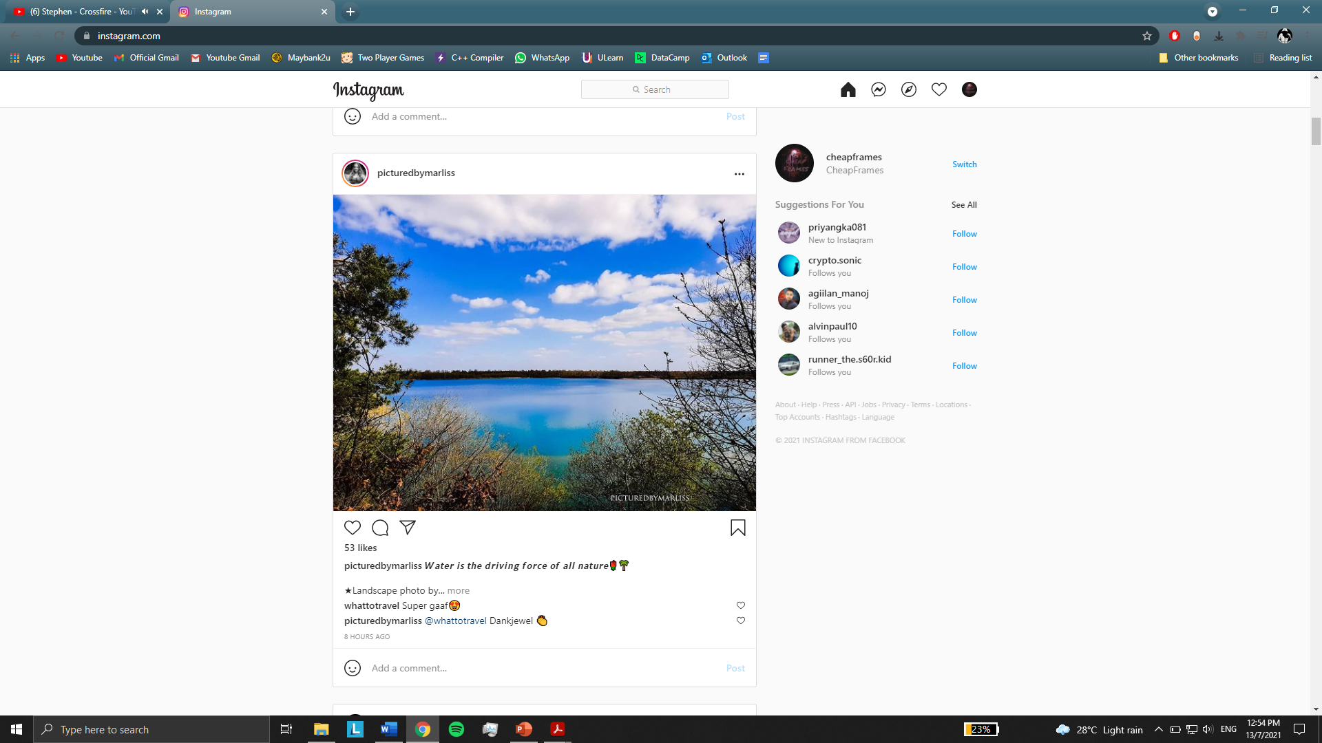
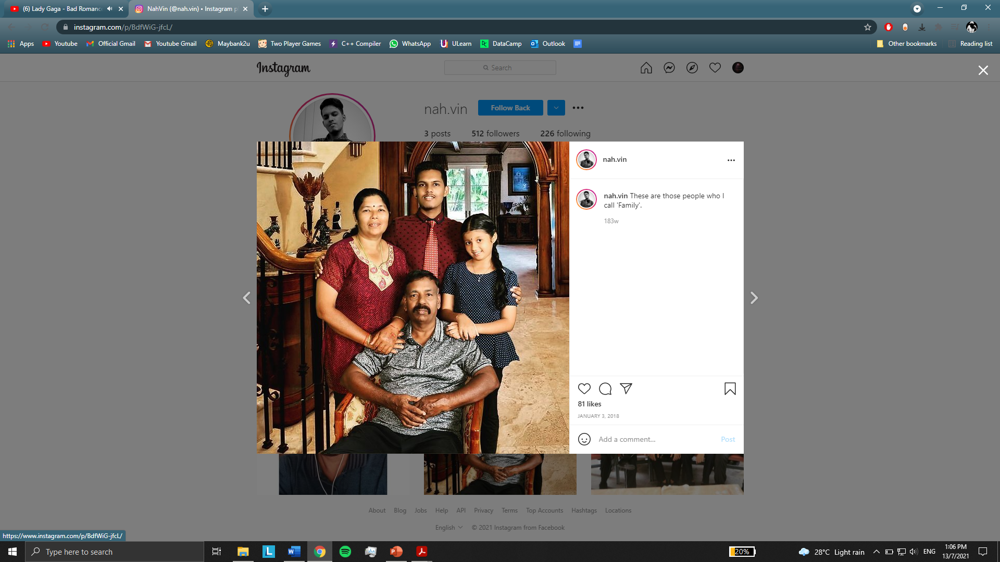
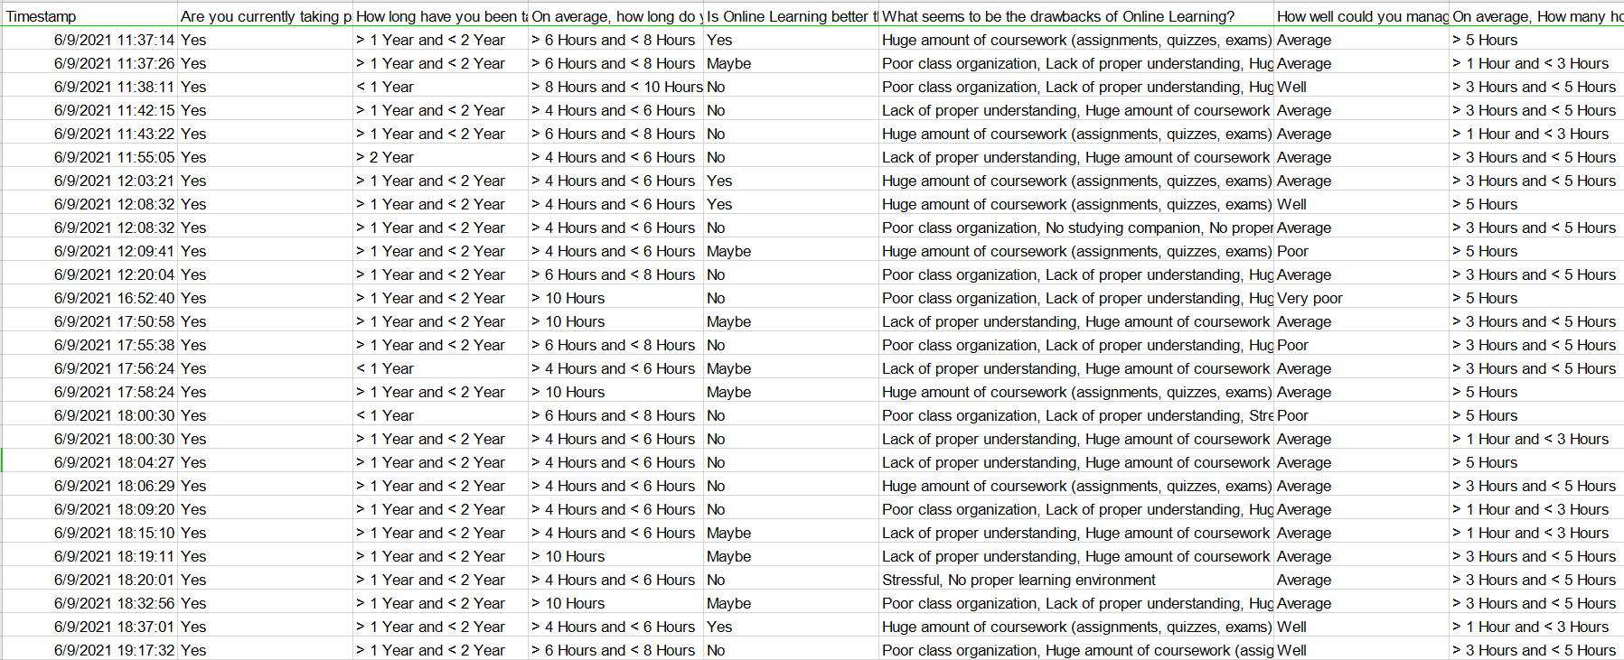
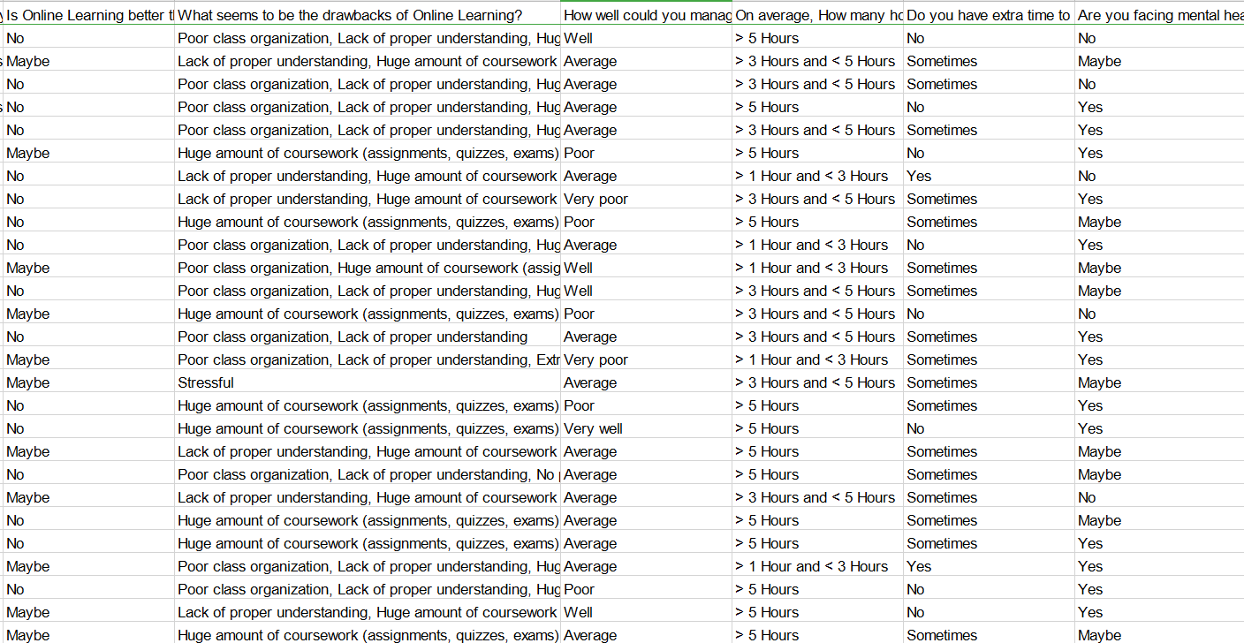
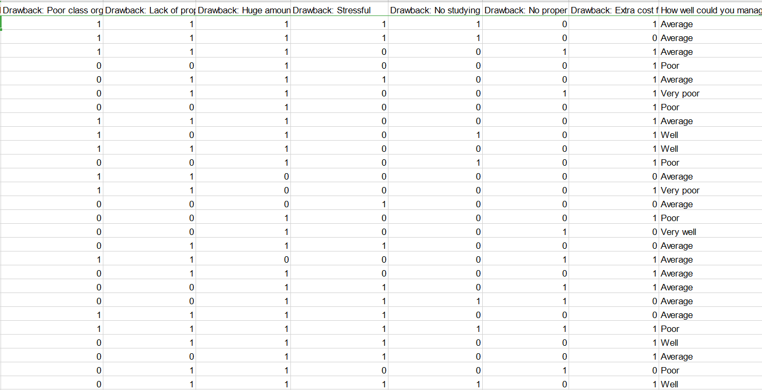
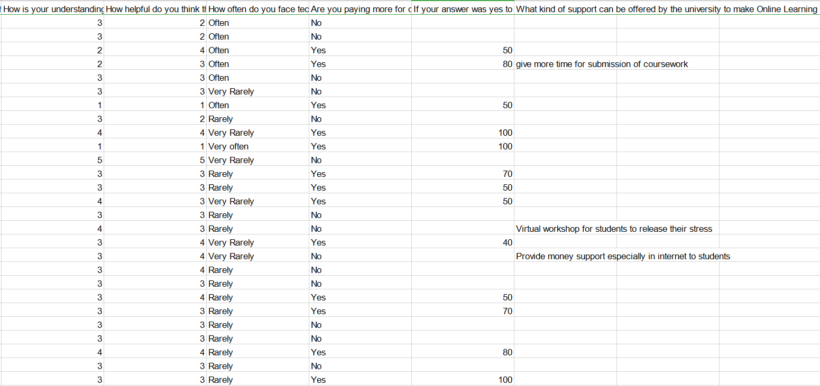
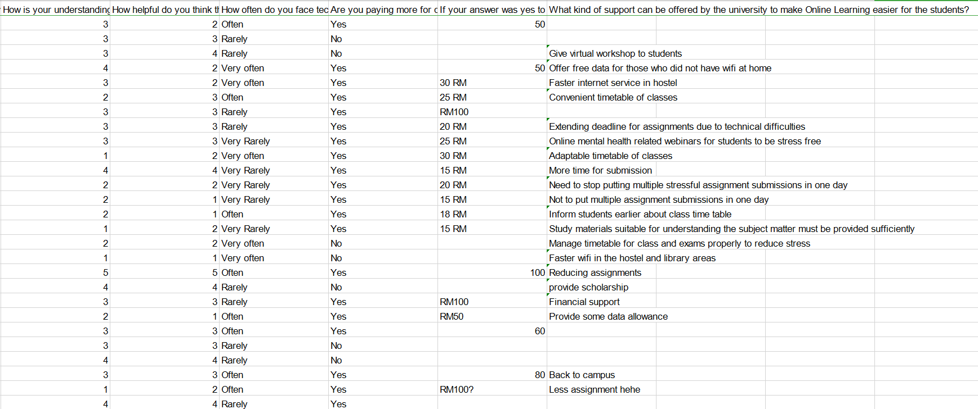
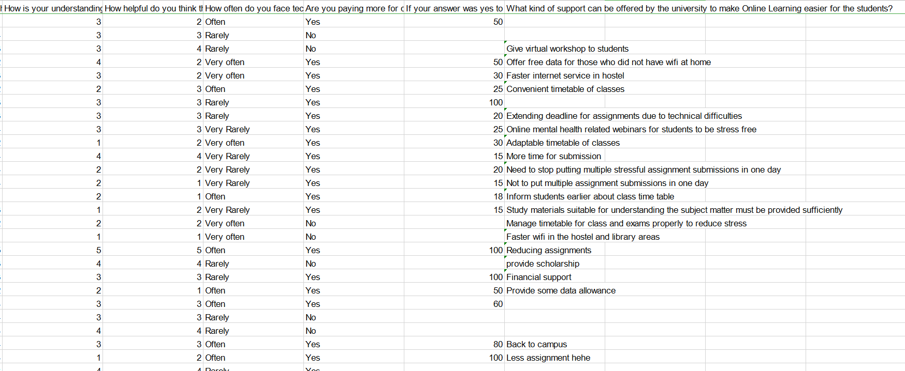
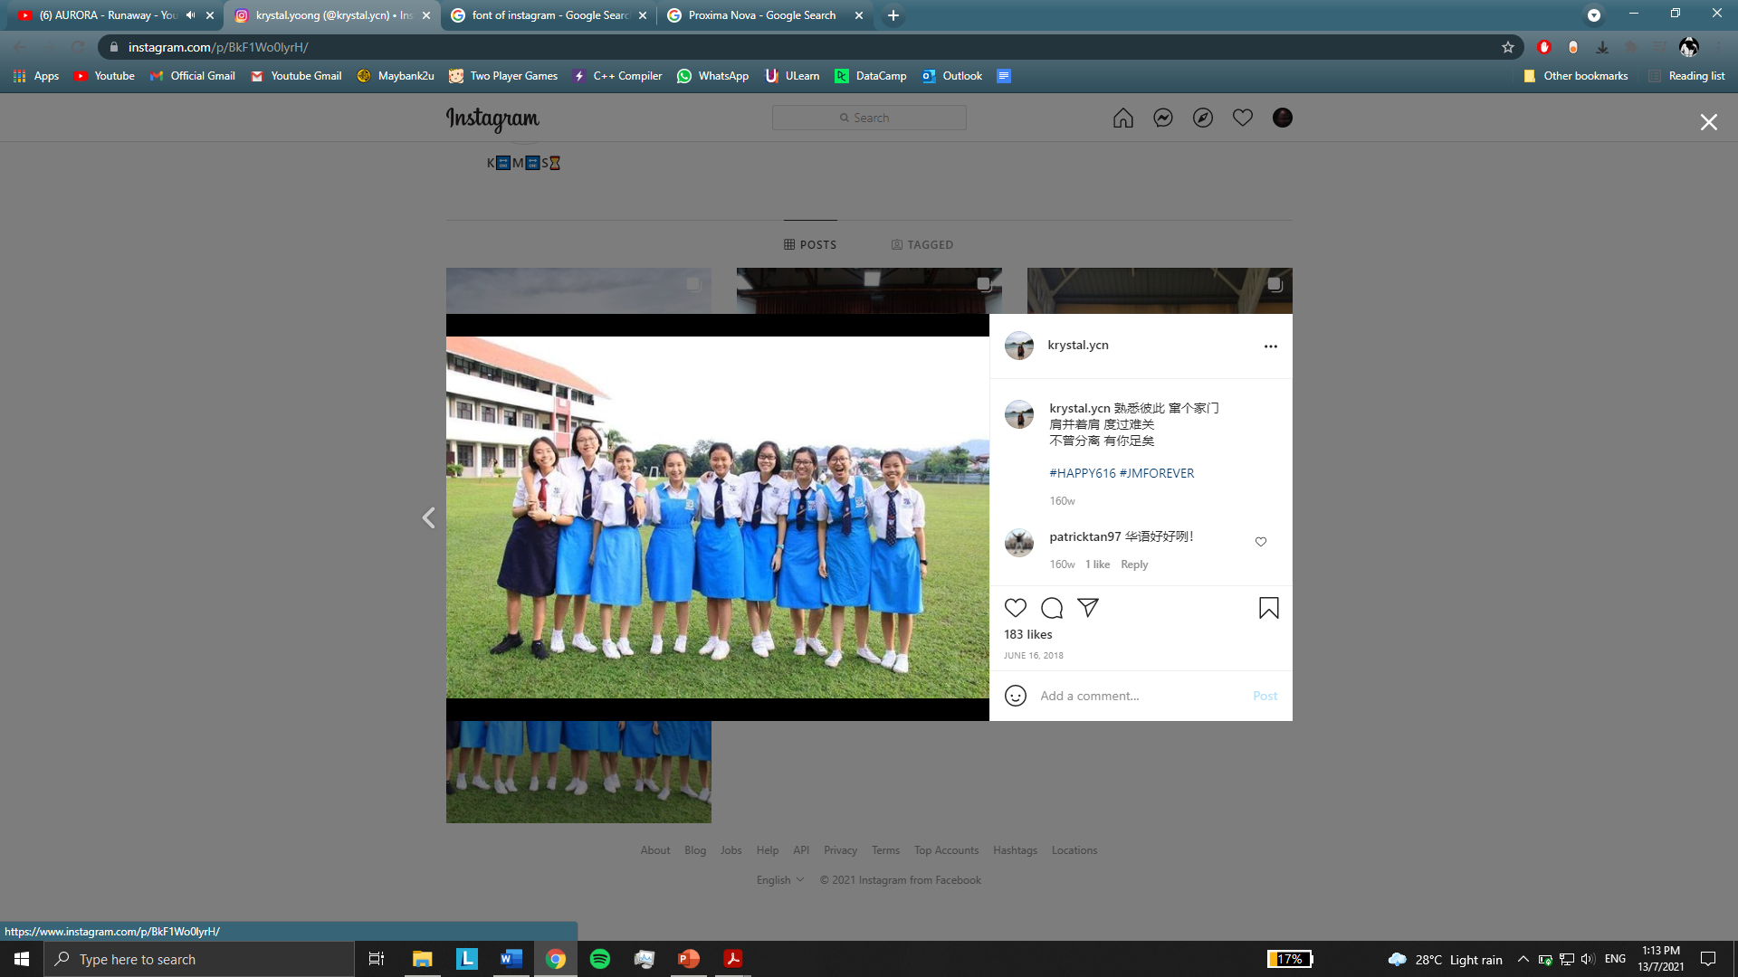
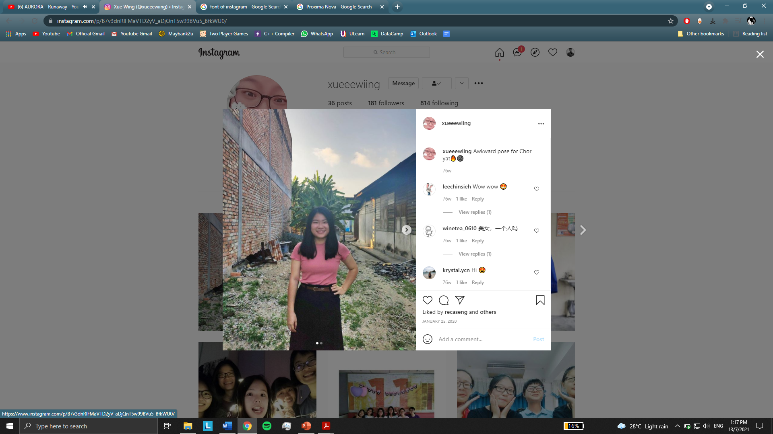



Data Cleaning
Data Reshaping
Data Management
Can someone help me clean this? #notdirty
Yea why not..
Can do eyes closed !)
tasnimfarabi
You gotta remove the unnecessary columns.

Slide 14
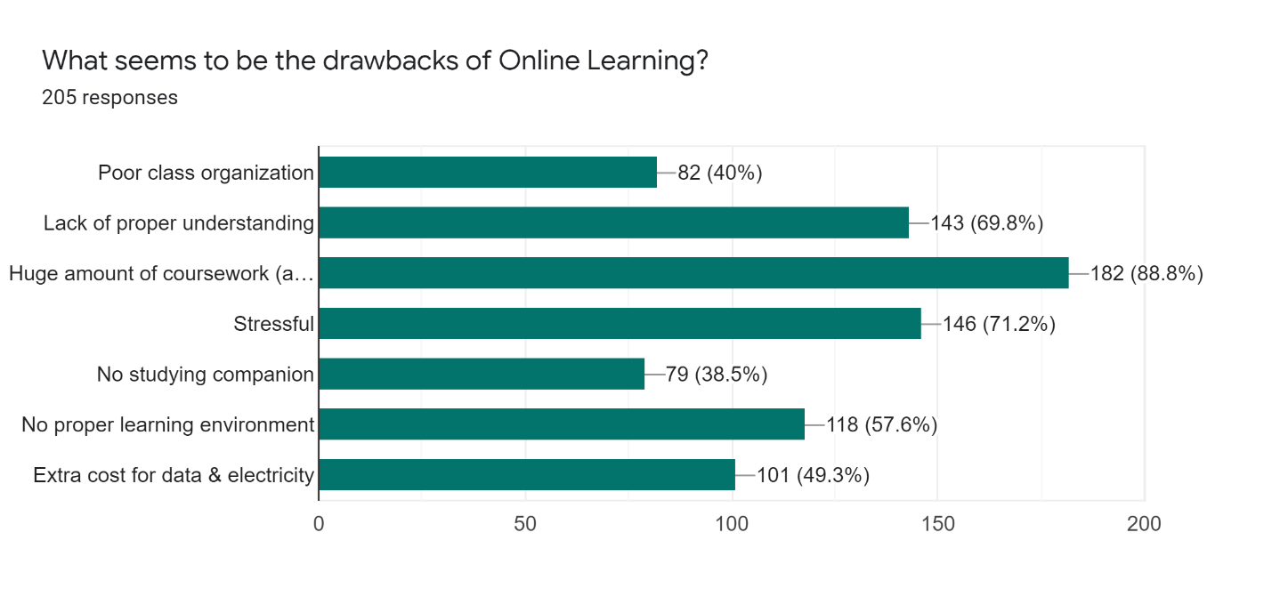
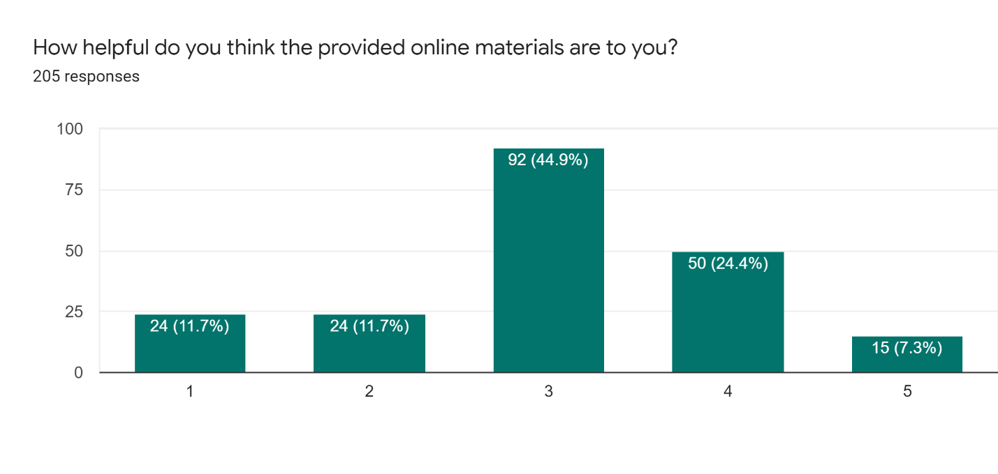
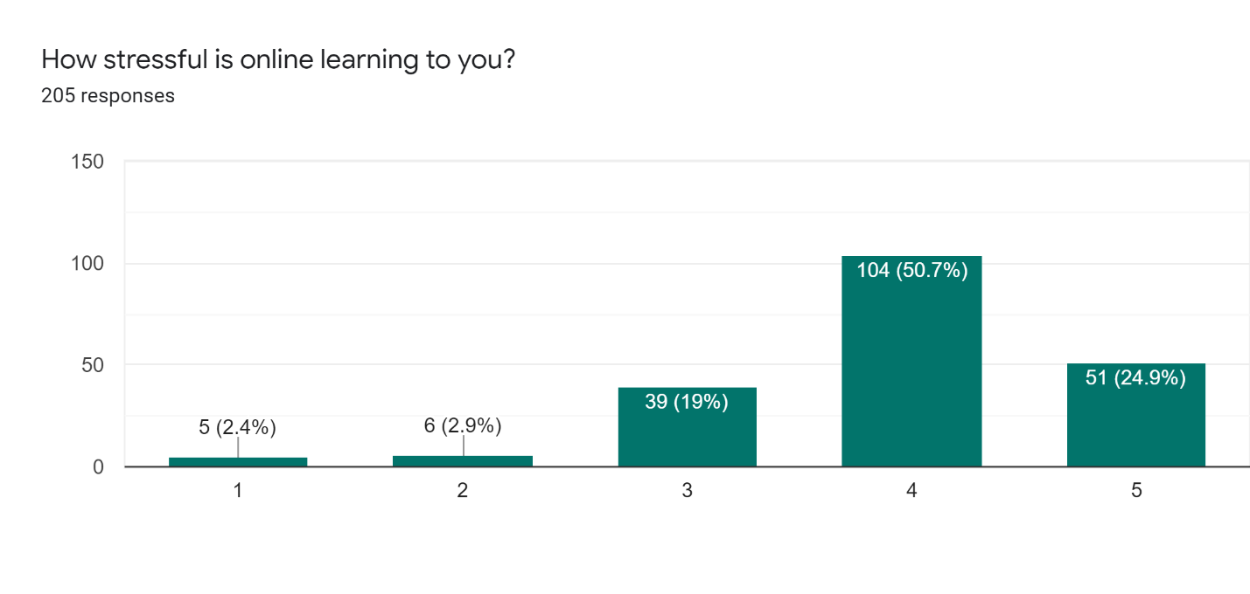
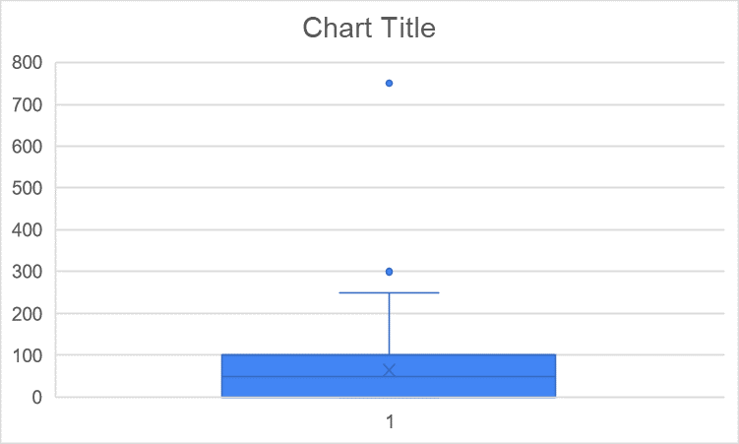
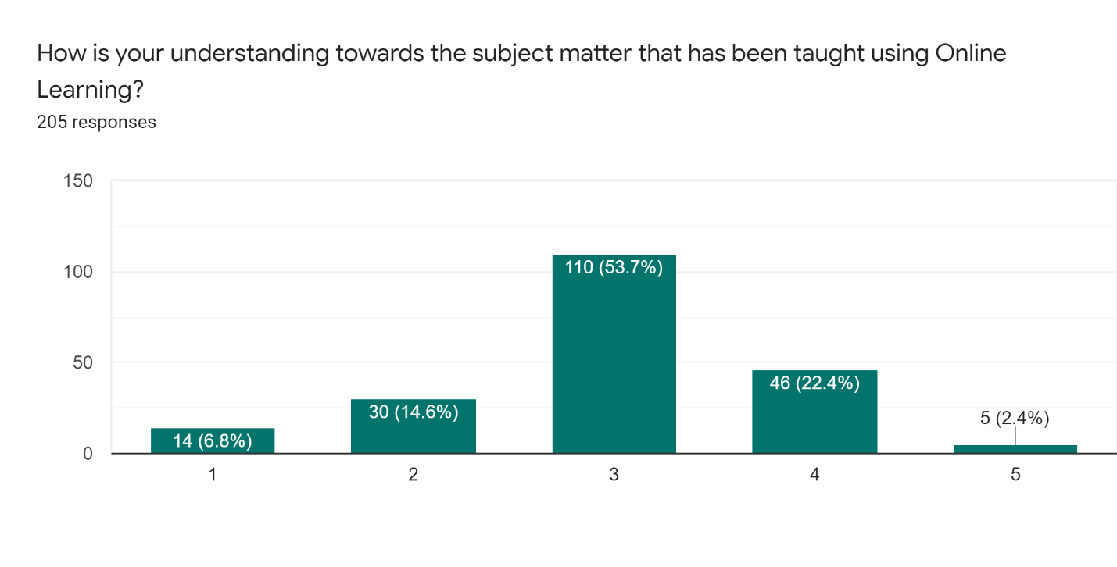
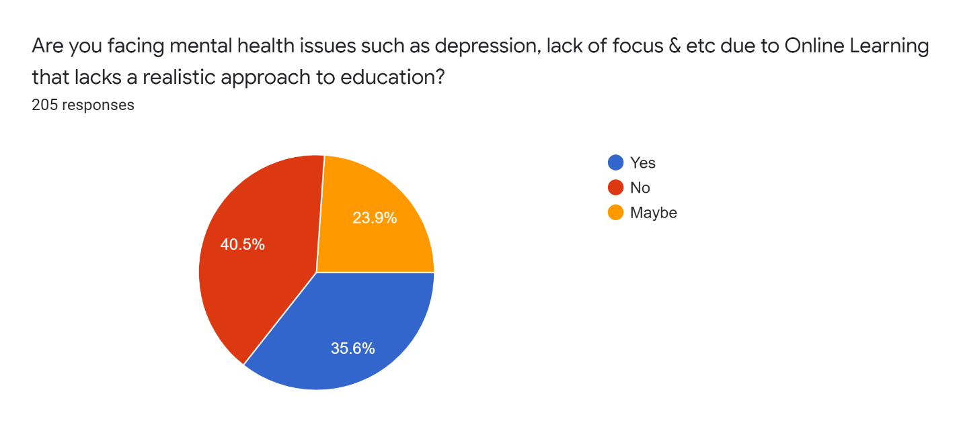
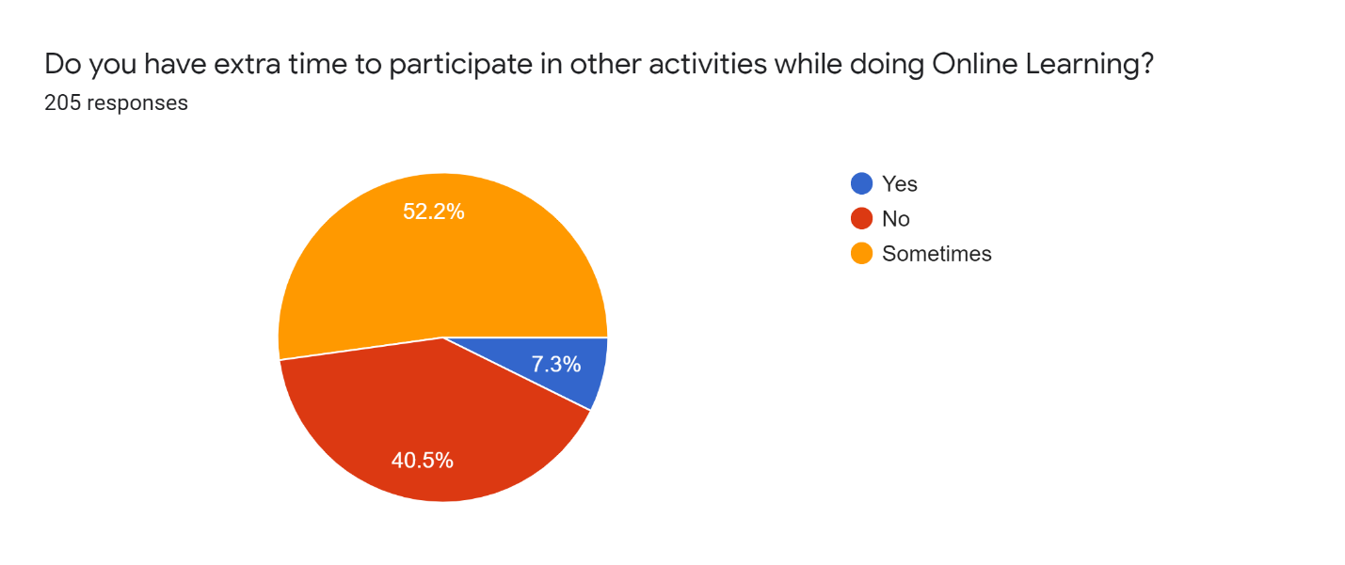
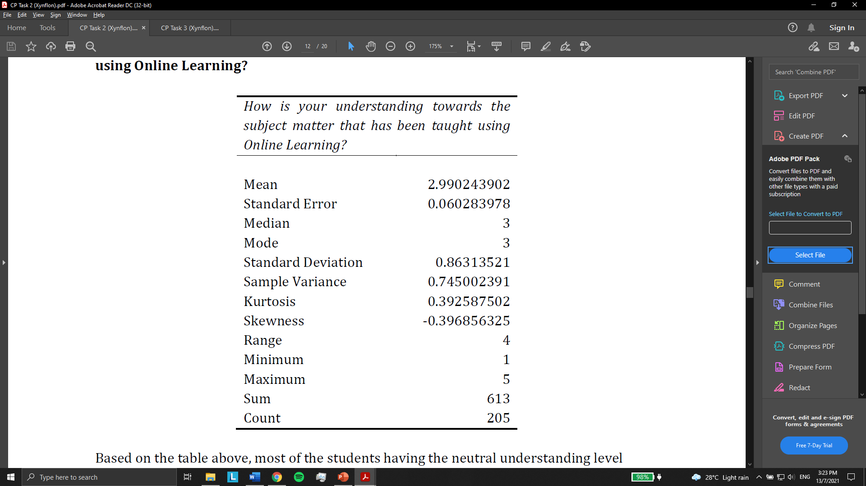

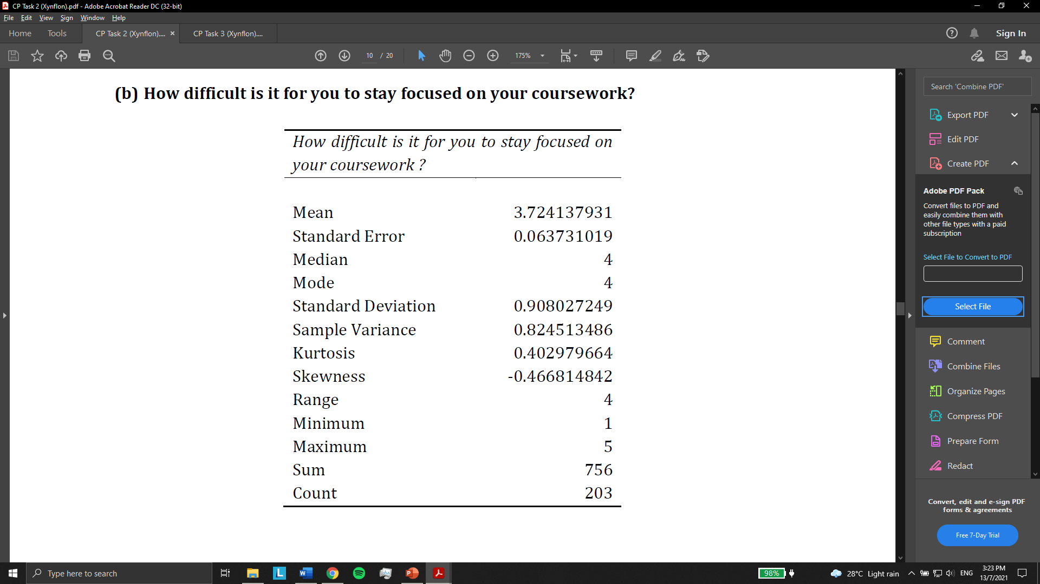
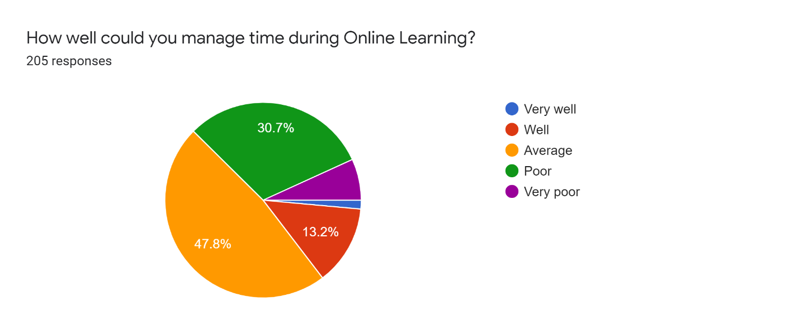
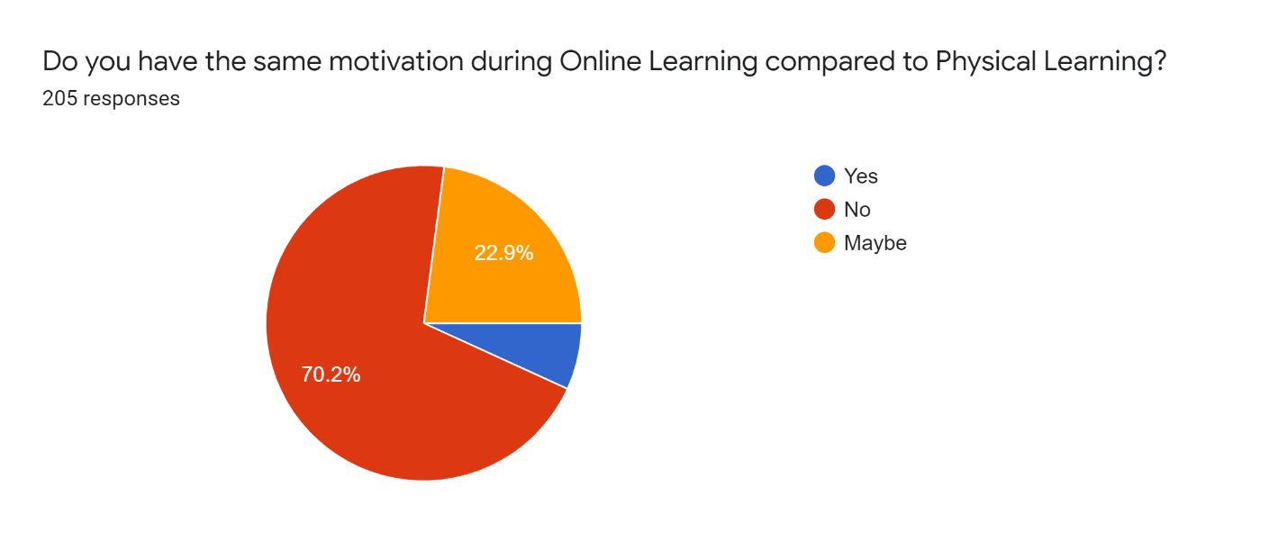
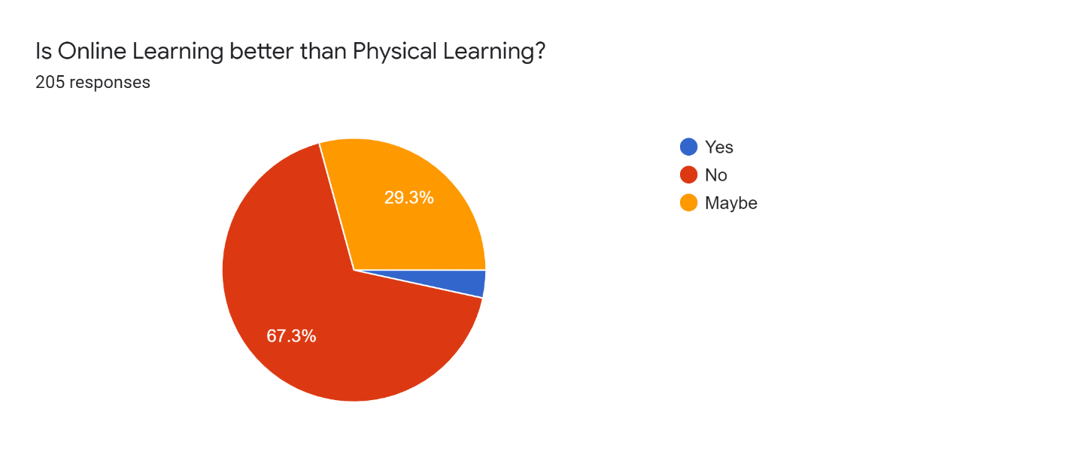
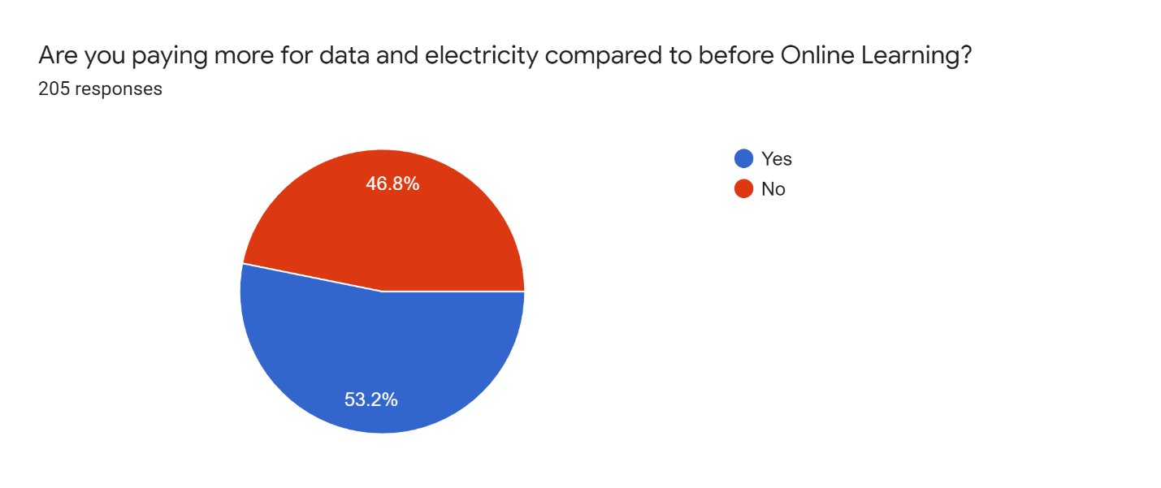
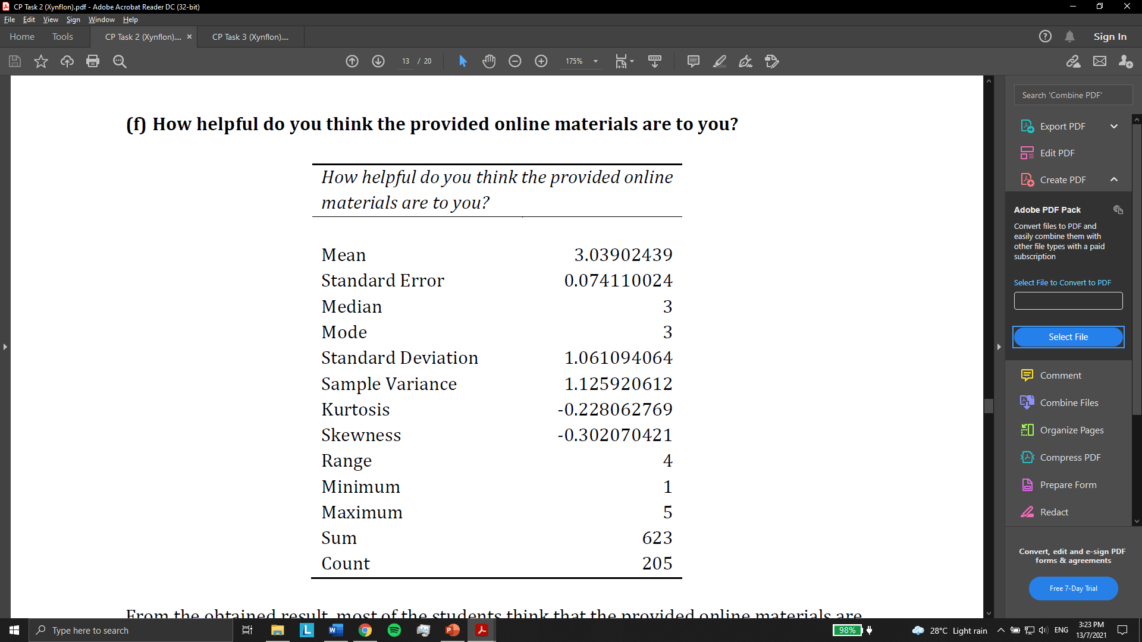
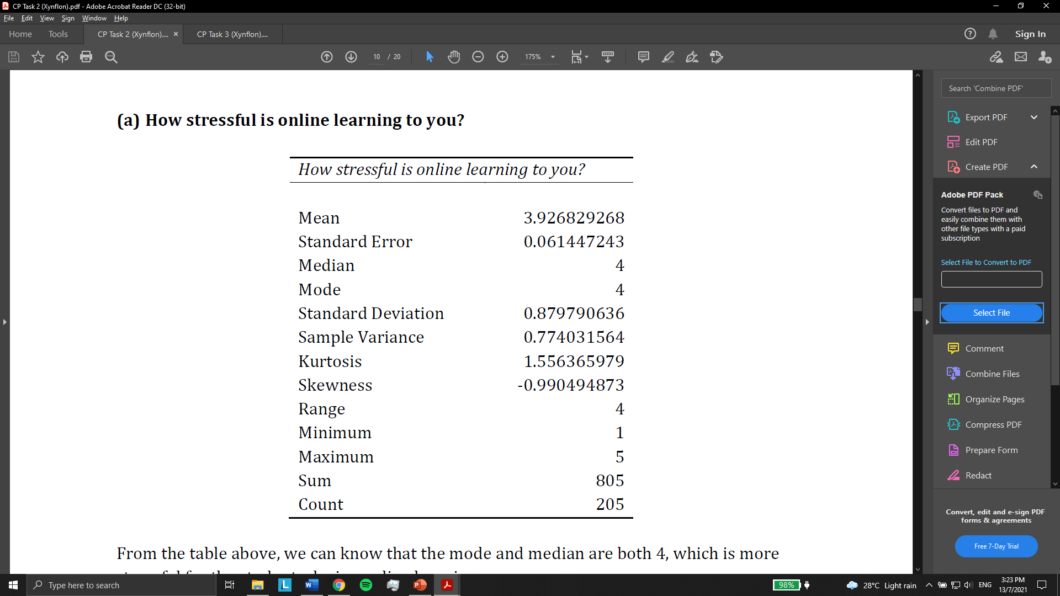
Data Cleaning
Data Reshaping
Address certain criteria
Understand
Data Management
Statistics
EDA
Variable: amount of money of the students spend on paying more for data and electricity compared to before Online Learning

Slide 15
04
TASK 3: Modelling & Evaluation

Slide 16

HOW ARE WE GOING TO MODEL?
Determine Class Label
Determine Possible Algorithm & Model
Determine Performance Metric
Implement Models
Determine the Best Model
Evaluate Models

Slide 17
“How stressful is online learning to you?” will be selected as the objective variable

Slide 18


MACHINE LEARNING
REGRESSION
CLUSTERING
CLASSIFICATION
Predict continuous values of output. It is used to predict the numeric data instead of labels.
Partition the dataset into a group of clusters to determine the grouping among unlabeled data.
The data is categorized into label and the label will be predicted for the data.
“ACCURACY”

Slide 19

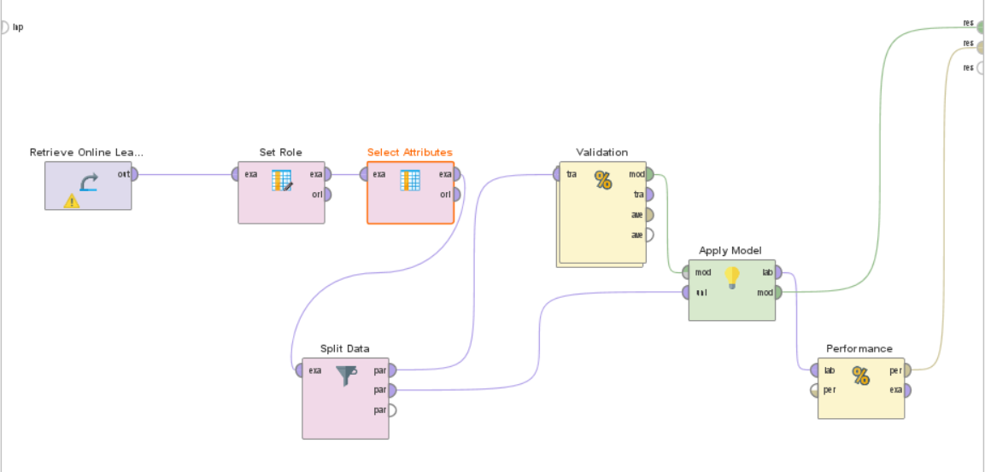
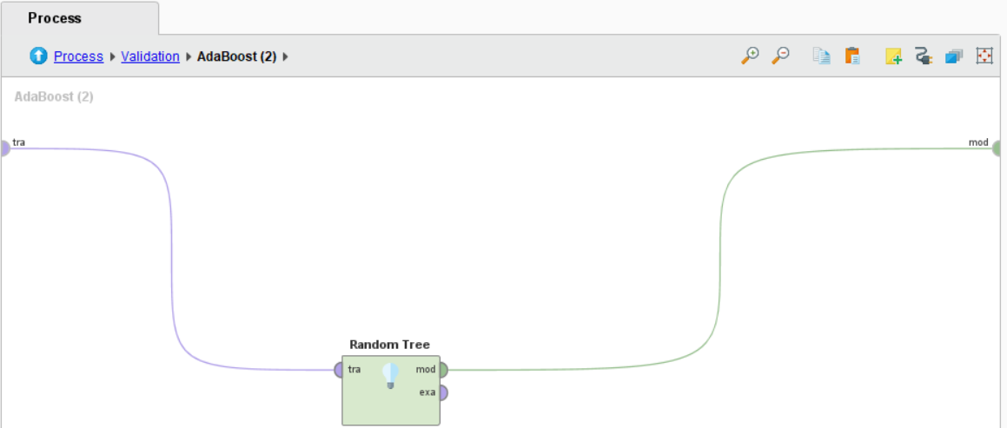
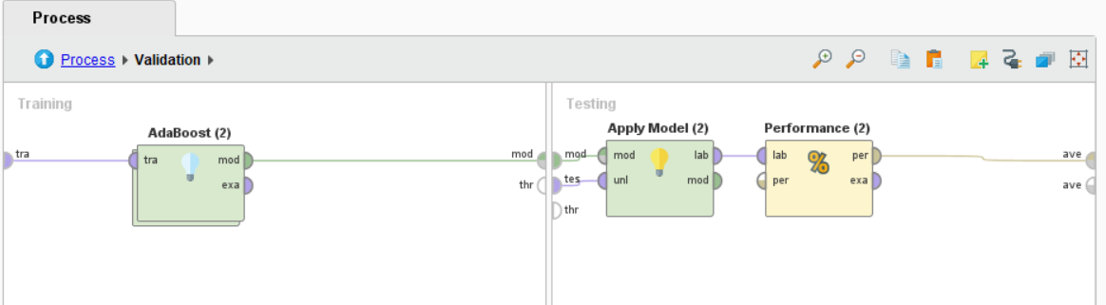
IMPLEMENTATION
We used Rapidminer to do Modelling and Evaluation

Slide 20
EVALUATION

Slide 21
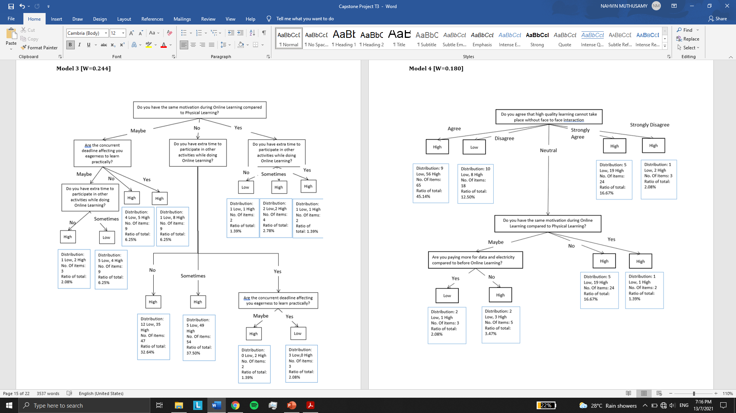
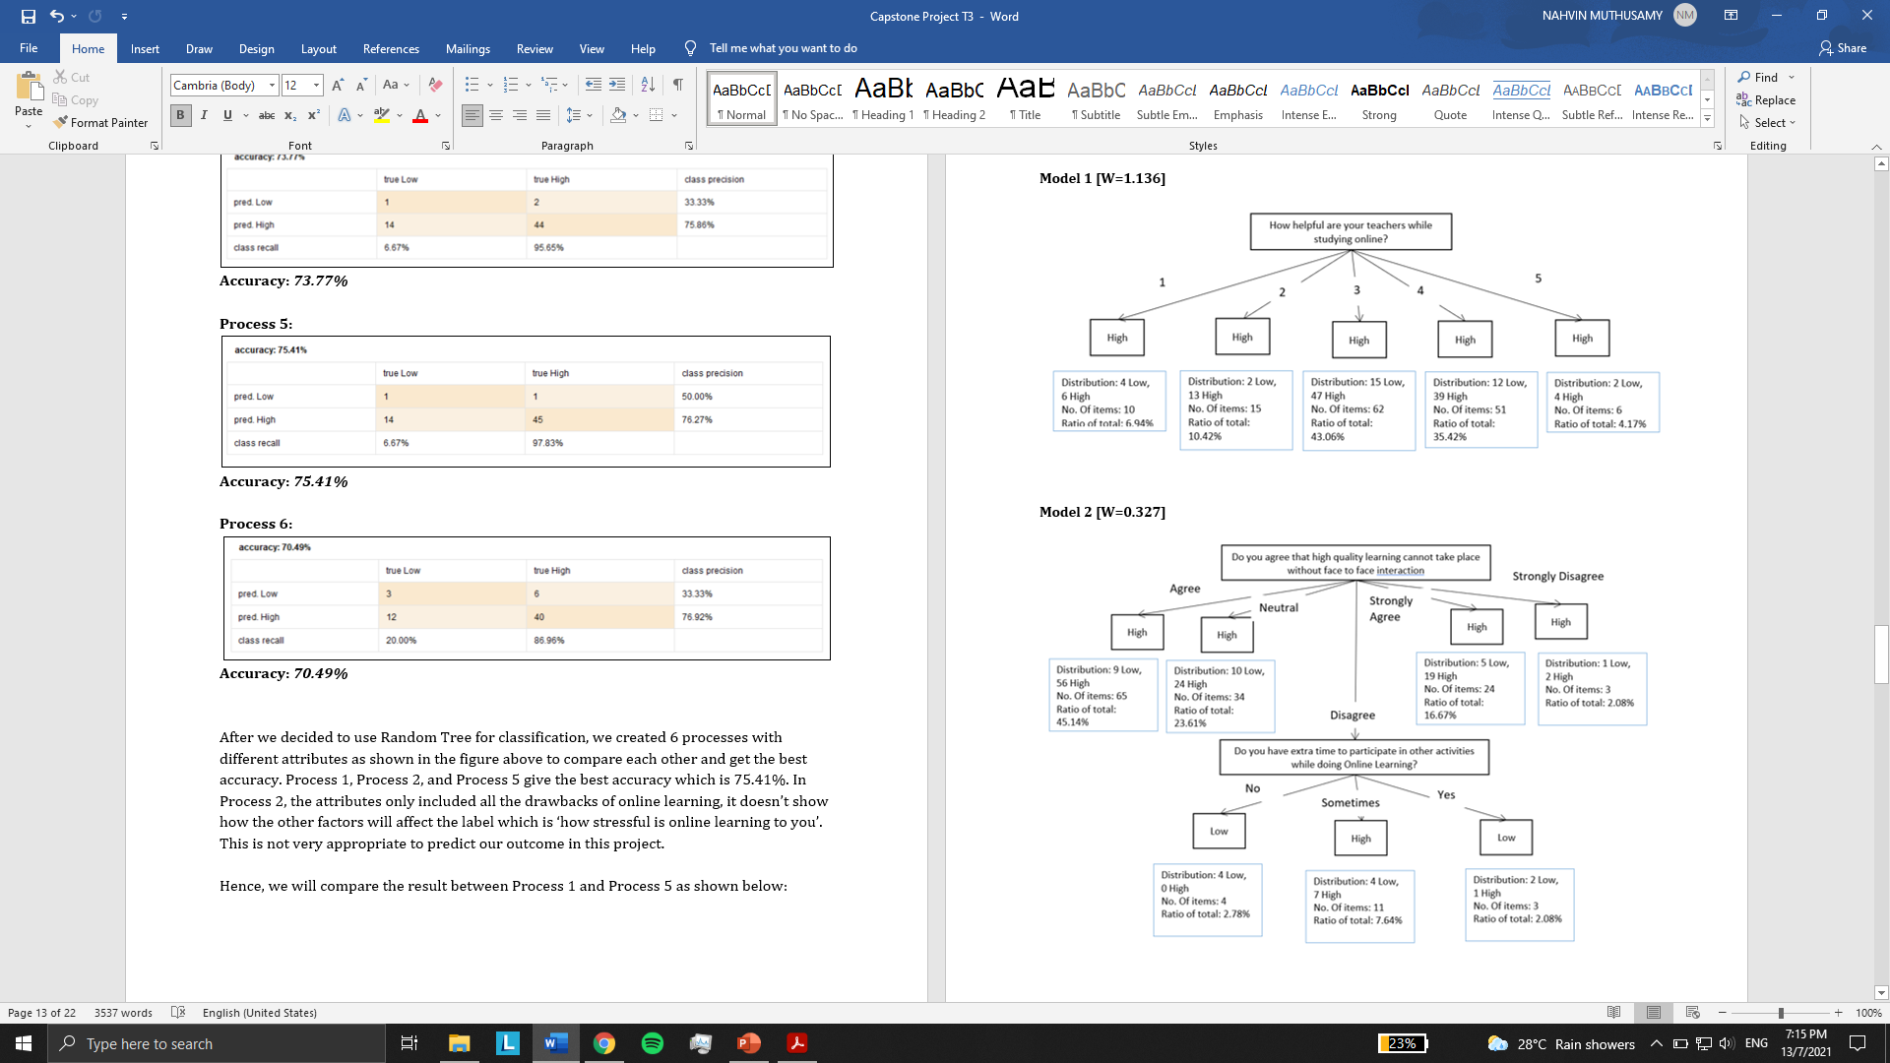
PROCESS 1 MODEL
ACCURACY = 75.41%

Slide 22
05
RECOMMENDATION

Slide 23
Implement Non-Linear Teaching Technique
RECOMMANDATION #3
RECOMMANDATION #1
RECOMMANDATION #2
Post-Submission Survey
Implement Hybrid Teaching with Sandbox Games

Slide 24
06
CONCLUSION

Slide 25
“ UiTM Kedah students died suspected to be due to study stress “
Source: BeritaHarian. July 10, 2021

Slide 26

THANK YOU

